Slide 1
Instacart Market Basket Analysis & Prediction
Prepared By- Parvez Noorani (DSOCT03)

Slide 2
5 - Step Project Pipeline
Import Libraries & Load Data
Exploratory Data Analysis
Get necessary features
Define Function
Predictive Model

Slide 3
Instacart
Whether you shop from scrupulous planned grocery lists or let whimsy guide your browsing, our unique food rituals define who we are. Instacart, a grocery ordering delivery app aim to make it easy to fill your ice chest with your personal favourites when you need them. Instacart’s data science team plays a big part in providing this delightful shopping experience. Instacart open-sourced this data of 3 Million Instacart Orders.

Slide 4
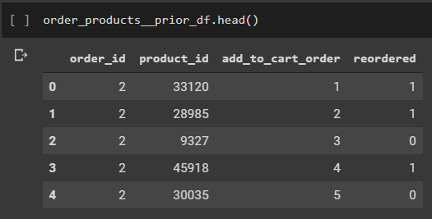
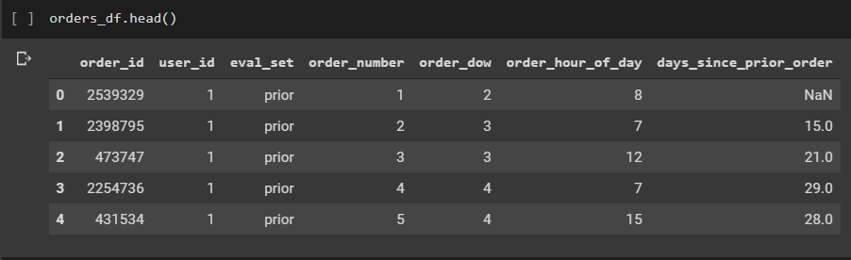
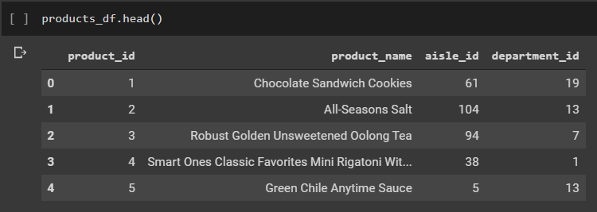
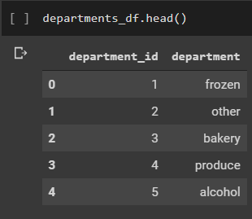
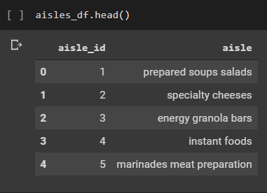
Datasets

Slide 5
Exploratory Data Analysis

Slide 6
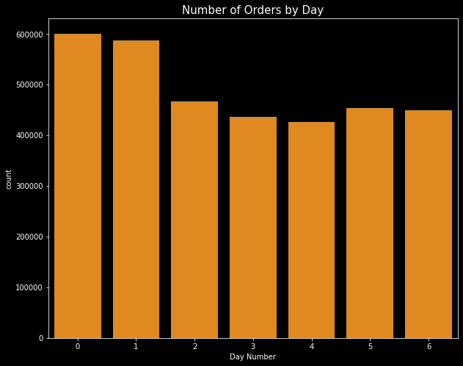
Order habits of Customer
From graph it seems 0 and 1 are Saturday and Sunday and 4 seems to be Wednesday when number of orders are low. A special discount/offer can be clubbed to increase sales on Wednesday.

Slide 7
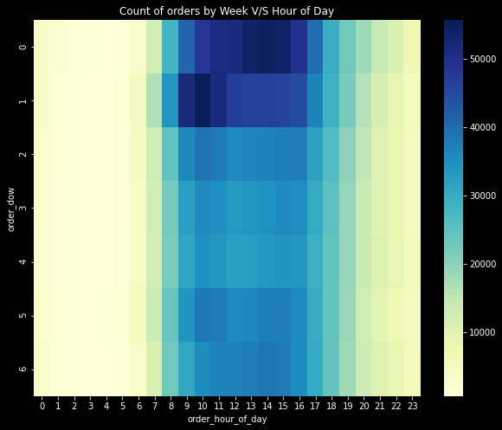
Merging day of week & time
From figure it is clear Saturday Evening and Sunday Mornings is the peak time for orders.

Slide 8
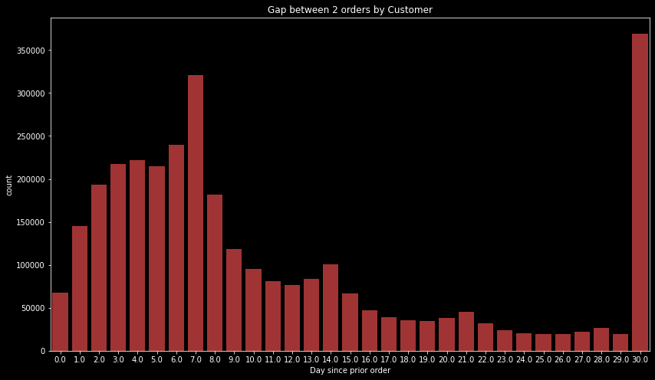
Gaps between 2 orders
It is clearly visible that majority customers prefer ordering once in 7 or 30 days and there is some good frequency at 14th, 21st & 28th day. (i.e. Weekly Intervals)

Slide 9
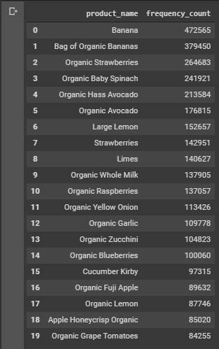
Top product with count
It seems people ordering like to remain fit as highest frequency products are majorly organic producs specially organic fruits

Slide 10
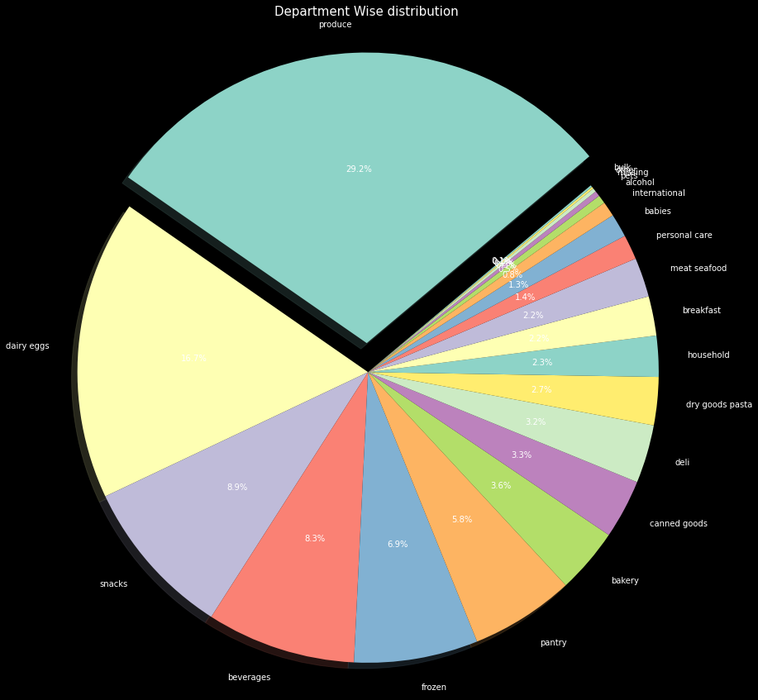
Department wise distribution
Produce is the largest department at 29.2% followed by Dairy- eggs and Snacks.

Slide 11
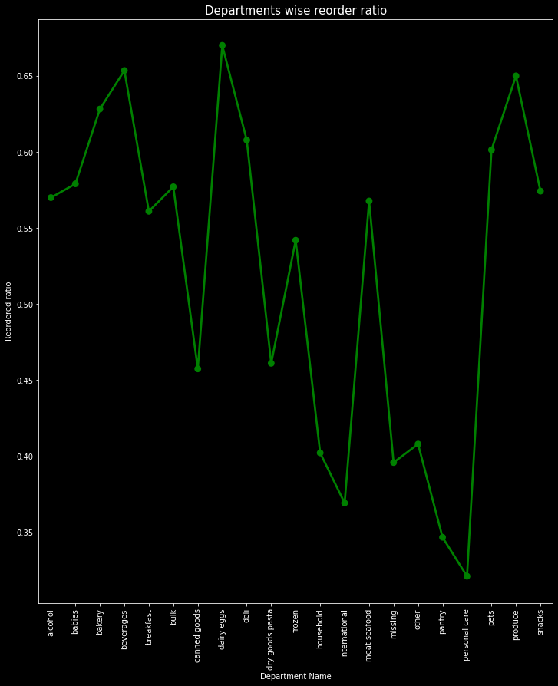
Re-order ratio by Department
From figure personal care items has least re-order ratio whereas dairy-eggs being the highest.

Slide 12
XGBoost Algorithm
XGBOOST: Its name stands for eXtreme Gradient Boosting. XGBoost is a scalable and accurate implementation of gradient boosting machines and it has proven to push the limits of computing power for boosted trees algorithms as it was built and developed for the sole purpose of model performance and computational speed. Specifically, it was engineered to exploit every bit of memory and hardware resources for tree boosting algorithms.
Why use XGBoost?
As we already mentioned, the key features of this library rely on model performance, capable of handling large-scale data and execution speed

Slide 13
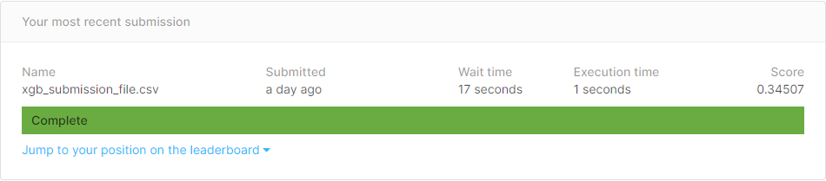
Results
Our code run on XGBoost and submission file on Kaggle scored 0.34507 on the Leaderboard.
Definitely there is scope of improvement in it as the Best Kaggle Score is 0.409 as on 25/05/20.

Slide 14
Thank You

